Slide 1
TRANSFUSION BIOLOGY AND THERAPY

Slide 2
TRANSFUSION BIOLOGY AND THERAPY
The study of RBC antigen and antibodies from the foundation of transfusion
medicine.
Antigens are either protein or carbohydrate assigned to a blood group system
based upon the structure and similarity of the determinant epitopes.
Alloimmunization is the production of antibodies directed against the blood group
antigens of another individual. These antibodies are called Alloantibodies.
Auto antibodies arise spontaneously in the same individual following natural
exposure to particular carbohydrates or protein that mimic some blood group
antigen
.
Alloimmunization with subsequent Alloantibodies production commonly manifest
during blood transfusion. The Alloantibodies are directed towards the RBC’s,
WBC’s, platelets and plasma antibodies. This may result in transfusion
complications e.g. fever, urticaria and haemolysis.

Slide 3
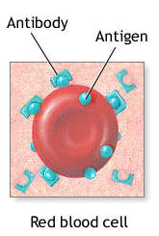

Slide 4
RBC blood group systems and Alloantigens
ABO (Antigens and antibodies) system
  The major blood groups of this system are A, B, AB and O
  AB has both A and B Antigens (produces no Abs i.e. universal recipient)
  A type lack B Ag. (Produces anti – B)
  B type lack A Ag. (Produces anti – A)
  Type O has no A and B Antigens (Produces both A and b Antibodies)

Slide 5
Rhesus system (Rh – system)
  Rh. System is the second most important blood system in pre – transfusion
  testing
  Rh antigens are found on RBC membrane protein. The most important
  antigen noted is the D- Antigen
  The presence of D – antigen confers Rhesus positivity while persons lacking
  it are termed rhesus – negative
  The D- antigen is a potent alloantigen. ≈ 15% of individuals lack this antigen.
  Exposure of these Rh – negative people to even small amounts of Rh –
  positive cells either by transfusion or pregnancy can result in the production
  of anti – D alloantibody.

Slide 6
Other blood group systems and Alloantibodies
More than 100 blood group systems are recognized. The most important
though not routinely checked include:
    Lewis system
    I – system
    P – system
    MNSs U system
    Kell system
    Kid system
    Duffy system
These are important in cross matching of blood because incompatibility may
be significant resulting in transfusion reaction e.g. fever and urticaria

Slide 7
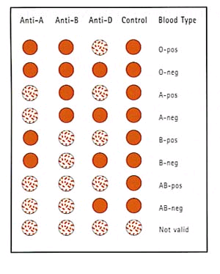

Slide 8
Pre – Transfusion Testing
Pre transfusion testing of a potential recipient consists of:
  Grouping according to ABO system and D-Ag. This is done by taking the
  recipients blood and mixing the sera against A, B and D Antigens
  Cross – Matching
    Blood selected for cross matching must be A, B and O compatible
    Reactive cross matching confirms presence of other Alloantibodies,
    which the patient may be against the donor cells or proteins.

Slide 9
In case of Rh – negative patients, every attempt must be made to provide Rh –negative blood components to prevent alloimmunization to the D – antigen.
In emergency situation, Rh – positive blood can be safely transfused to an Rh –negative patient who lacks anti –D antibodies.
However the recipient is likely to become alloimmunized and produce Anti – D in future transfusion.
Rh – negative women of childbearing age in this case should be given passive immunization with anti – D (Rhogan or winiRho) to reduce or prevent sensitization.

Slide 10
Blood components
Blood products intended for transfusion are routinely collected as whole
blood (450ml - 500ml) in various anticoagulants.
Donated blood can be processed into:
  Packed RBC’s
  Platelets
  Fresh – frozen plasma (FFP) – contain coagulation factors protein with
  C and S, anti-thrombin III
  Cryoprecipitate – fibrinogen factor 8,VWF

Slide 11
Whole blood is first separated into Packed RBC’s and platelets – rich plasma by
Slow centrifugation. The platelets rich plasma is then centrifuged at high speed
to yield one unit of random donor (RD) platelets and one unit of FFP.
Cryoprecipitate is produced by thawing FFP to precipitate the plasma proteins,
and then separated by centrifugation.
Ideally the patient should be transfused only what is needed i.e. RBC’s,
platelets, FFP or cryoprecipitate. Each component has specific indication,

Slide 12
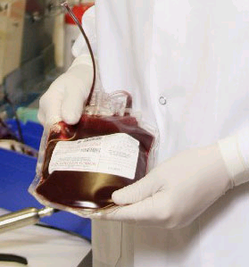
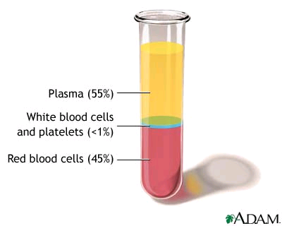

Slide 13
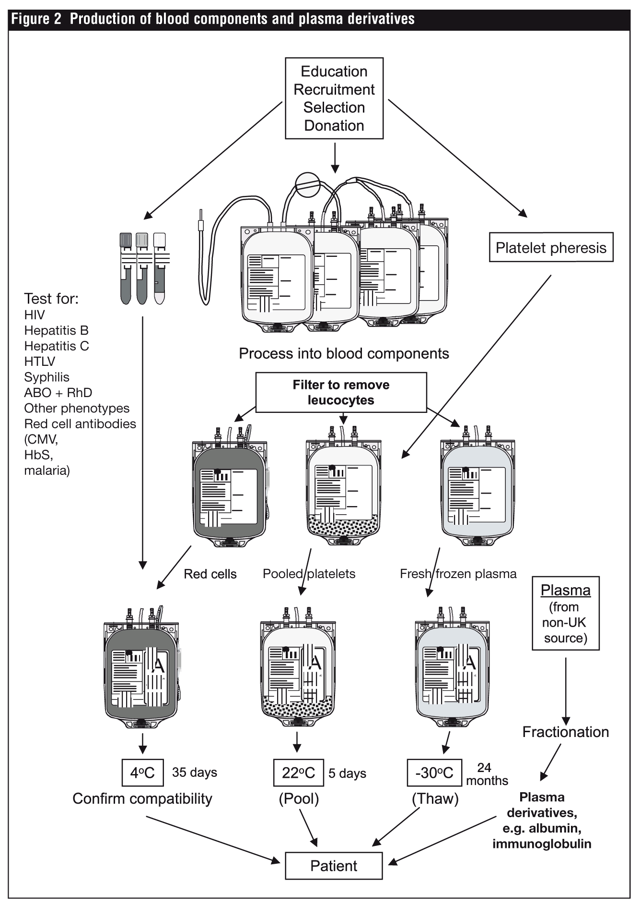

Slide 14
  Whole Blood
    Acute Haemorrhage
  Packed RBC’s
    Anaemia
  Platelets:
    Thrombocytopenia with risk of haemorrhage
    The threshold for prophylactic platelets transfusion is 10,000/ mm³
    invasive procedure at least 50,000 / mm³
  Fresh frozen plasma (FFP)
    Contains stable coagulation factors, plasma protein, fibrinogen, anti-
    thrombin III, albumin, protein C and S
    Indications include:
      Coagulopathies
      Anticoagulant reversal e.g. Warfarin

Slide 15
  Cryoprecipitate
    Contains fibrinogen, factor 8, VWF
    Indicated in haemophilia, (When factor 8 not available) VW- disease
  Plasma derivatives
    Contains protein concentrates, albumin, and immunoglobulin anti-
    thrombin and coagulation factors.
Adverse reaction to blood transfusion
Adverse reactions to transfused blood components occur despite multiple tests,
inspections and checks
When an adverse reaction is suspected, the transfusion should be stopped and
reported to blood bank for investigations.
Transfusion reactions may result from immune, non immune mechanisms and
infections complications

Slide 16
Immune – mediated reactions:
1) Acute haemolytic transfusion reactions.
  Occur when recipient antibodies lyses donor RBC’s
  The ABO agglutinins are responsible for majority of these reactions.
  presents with: -
    Hypotension
    Tachycardia
    Fever / chills
    Chest pains
    Loin pains
    Discomfort at the infusion site.
  Other findings:
    Haemoglobinaemia
    Haemoglobinuria

Slide 17
  When acute haemolysis is suspected the transfusion must be stopped
  immediately. The blood should be returned back to the blood bank for
  analysis.
  Things to be done:
    Lab investigations:
      Serum haptoglobulin
      Lactate dehydrogenase
      Indirect bilirubin levels
      Coagulation studies (Including PT and PTT) due to risk of DIC from
      tissue factors released from erythrocyte.
      Fibrinogen levels
      Platelets count.
    R_{X}:
        Diuresis with Frusemide or mannitol with IVF.
        I.V steroid e.g. dexamethasone / hydrocortisone

Slide 18
2) Delayed haemolytic and serologic transfusion reaction:
  Difficult to prevent usually not stormy.
  Occurs 1 – 2 weeks following transfusion
  No specific therapy is required
3) Febrile non haemolytic transfusion reaction
  The most frequent reaction of transfusion
  Abs directed against donor WBC, cytokines and HLA – Ag are thought to
  mediate these reactions.
  R_{X}: - Paracetamol or other antipyretic drugs

Slide 19
5) Allergic Reactions:
  Urticaria reaction: these are thought to be related to plasma proteins found
  in transfused components
6) Anaphylactic reaction:
  Occurs immediately with first few drops of transfused blood. Presents with:
    Difficulty in breathing
    Coughing
    Dyspnoea
    Nausea and vomiting
    Hypotension
    Bronchospasm
    Loss of consciousness
    Respiratory arrest
    Shock.
  R_{X}: -
    Stop transfusion
    S.C Adrenaline 0.5 – 1.0ml of 1: 1000 dilution
    I.V steroids: dexamethasone or hydrocortisone
    Patients with IgA deficiency are at a notably higher risk of
    anaphylactic reaction.

Slide 20
7) Graft – versus – Host Disease (GVHD)
  Occurs when lymphocytes from donor blood attack and cannot be
  eliminated by immunodeficient host.
  Presents with fever, cutaneous eruption, diarrhoea and LFT’s
  abnormalities
  R_{X}: -
    Supportive
8) Post Transfusion Purpura:
  Presents with thrombocytopenic purpura usually after platelets
  transfusion.
  Platelets specific antibodies are found on patients (recipients) serum.
  R_{X}: -
    Intravenous immunoglobulin to neutralize the effector’s Ab’s
    Plasmapharesis to remove Ab’s
9) Alloimmunization:
  Important in rhesus – negative women of childbearing age.
  Presents with haemolytic disease of the newborn with hydrops fetalis in
  subsequent pregnancies.

Slide 21
Non – Immunologic Reactions:
1) Fluid overload.
  Blood components are excellent volume expanders and transfusion may
  quickly lead to volume overload.
  R_{X}: -
    Monitor rate and volume of transfusion
    Use of I.V Diuretic
  Hypothermia
    Refrigerated blood component (Usually at 4⁰c) or frozen blood component (Usually at 18⁰c or below) can result in hypothermia when rapidly infused.
    R_{X}: - use of in – line warmer.

Slide 22
  2) Electrolyte Toxicity
    RBC haemolysis during storage increases the concentration of
    potassium in the unit.
    Neonates and patients with renal failure are at a risk of hyperkalaemia.
  3) Iron overload
    Each RBC packed cell unit contains 200 – 250 mg of Fe. Fe overload
    may occur.
    R_{X}: - desferrioxamine.

Slide 23
Infectious complications;
1) Viral infections;
  HIV Infection
  Hepatitis B virus
  Hepatitis C virus
  Hepatitis G virus
  Cytomegalovirus
  Human T- Lymphotrophic virus-1 (HTLV-1)
  Parvovirus (notorious for causing aplastic anaemia.
2) Bacterial Contamination;
  Yersinia
  Pseudomonas
  Syphilis
3) Other Infectious Agents;
  Malaria Parasite
  Chagas disease
  Lyme disease
  Creutzfeld-Jacob disease.

Slide 24
Alternatives to transfusion:
Autologous blood is the best option when transfusion is anticipated. Alternatives to transfusion include:
Oxygen – carrying blood substitutes e.g. perfluorocarbons and aggregated
haemoglobin solution. These are still in various stages of clinical trials.
Granulocyte and granulocyte – macrophage colony stimulating factors; are
clinically useful to hasten leucopenia related to high dose chemotherapy.
Erythropoietin:- stimulates erythrocyte production in patients with anaemia of
chronic renal failure and other conditions thus avoiding or reducing need for
transfusion.
Thrombocytopoeitin :- is a cytokine that promotes megakaryocytic proliferation
and maturation. It is currently being tested for its ability to reduce the need for
platelet transfusion

